Slide 1
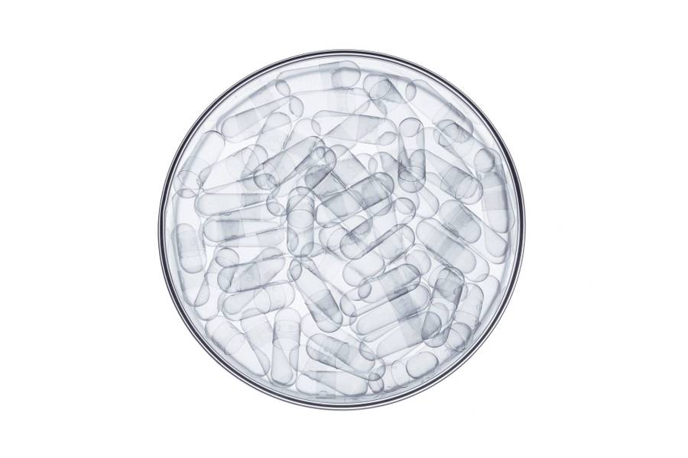
ML Systems DESIGN Meetup Group
Hetav Pandya

Slide 2

Agenda
Introduction
Overview of Machine Learning Systems
Introduction to Machine Learning Systems Design
Open Q&A

Slide 3
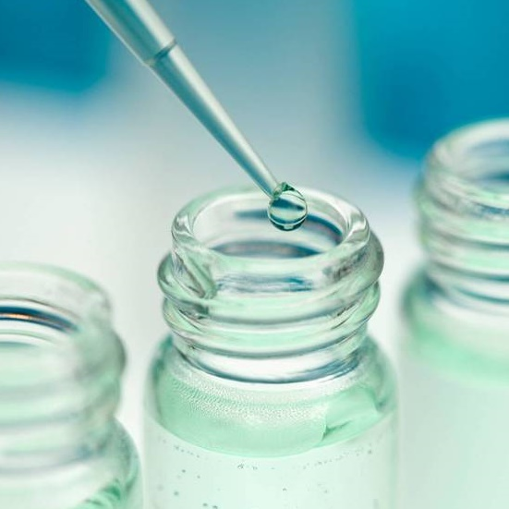
Introduction
Welcome to ML Systems Design Meetup Group
Designing Machine Learning Systems – Chip Huyen
Two chapters every meeting
Free Access – City Library
Frequency – Biweekly - Monthly
Questions: Meetup Event Chat

Slide 4
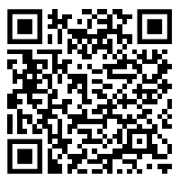
Free access
Via Burnaby Public Library

Slide 5

Overview of Machine Learning Systems
Data Stack
Monitoring
ML Algorithms
Business Requirements
Infrastructure

Slide 6
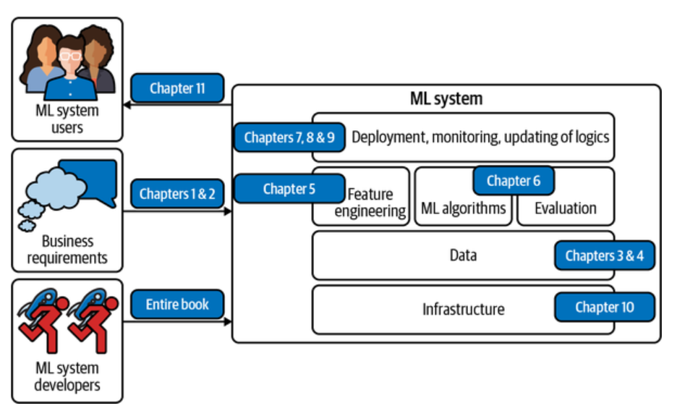
The Book in a nutshell

Slide 7
Where can ML Help?
Machine learning is an approach to (1) learn (2) complex patterns from (3) existing data and use these patterns to make (4) predictions on (5) unseen data.

Slide 8
Where can ML Help?
It’s repetitive
The cost of wrong predictions is low
It is required at scale
Patterns are constantly changing

Slide 9
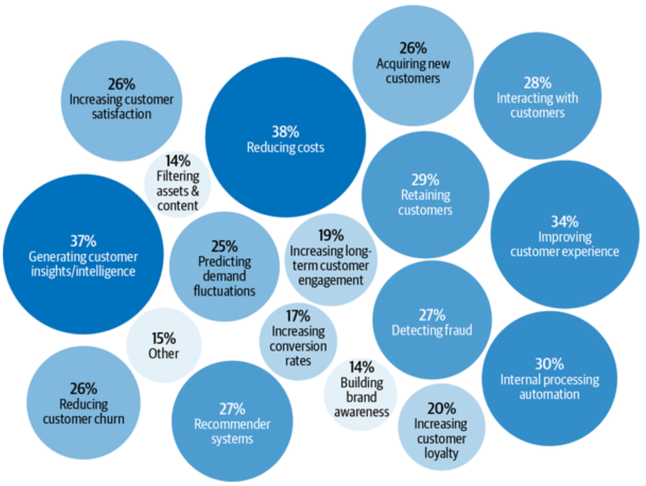
Where can IT help you?

Slide 10
Where can IT help you?
As of 2019, the average cost for an app to acquire a user who’ll make an in-app purchase is $86.61. The acquisition cost for Lyft is estimated at $158/rider. This cost is so much higher for enterprise customers. Customer acquisition cost is hailed by investors as a startup killer. Reducing customer acquisition costs by a small amount can result in a large increase in profit

Slide 11
Where can help you?
The cost of acquiring a new user is approximated to be 5 to 25 times more expensive than retaining an existing one. Churn prediction is predicting when a specific customer is about to stop using your products or services so that you can take appropriate actions to win them back.

Slide 12
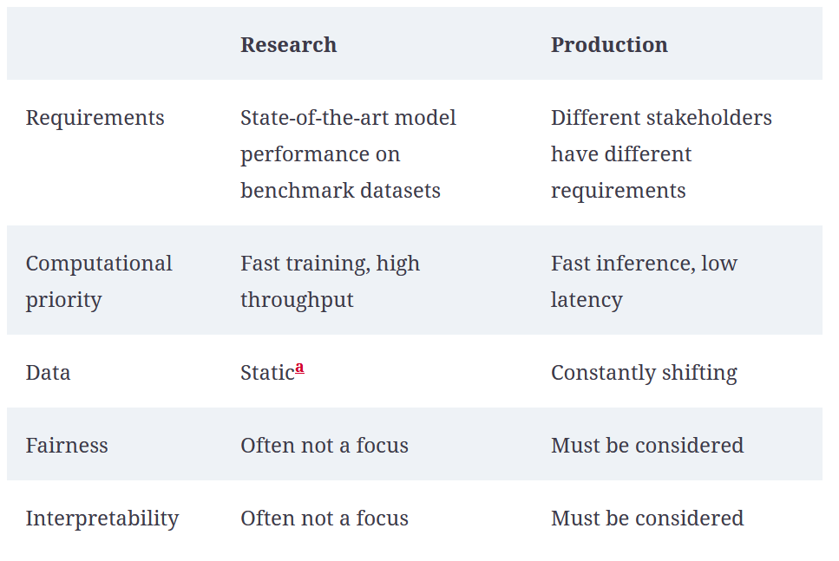
CS101: Intro to ML

Slide 13
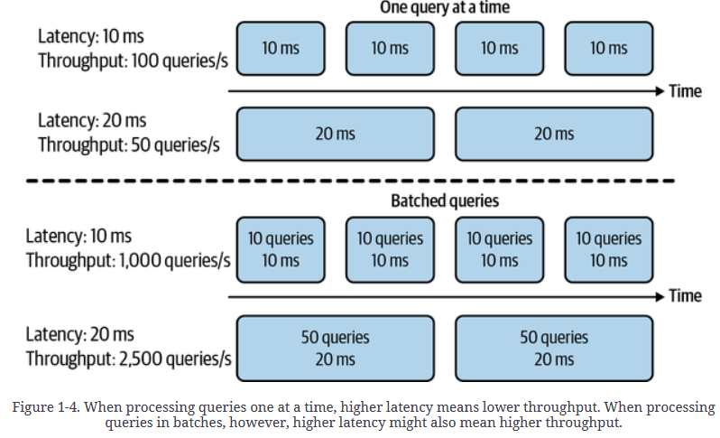
Inference vs throughput

Slide 14
Inference vs throughput
In 2019, Booking.com found that an increase of about 30% in latency cost about 0.5% in conversion rates—“a relevant cost for our business.” In 2016, Google found that more than half of mobile users will leave a page if it takes more than three seconds to load. Users today are even less patient.

Slide 15
Interpretability
SHAP
CAPTUM
“Suppose you have cancer and you have to choose between a black box AI surgeon that cannot explain how it works but has a 90% cure rate and a human surgeon with an 80% cure rate. Do you want the AI surgeon to be illegal?”
LIME

Slide 16
ML vs Software*
I need data, more data, good data, consistent data!
I need precise, concise and maintainable logic
VS
* Traditional software – deterministic paradigm

Slide 17
ML vs Software*
Need to version code and data
Need to version code
VS
* Traditional software – deterministic paradigm

Slide 18
ML vs Software*
Need more resources, RAM, CPU, GPU, TPU!
I am usually content with 4GB RAM… unless I am chrome
VS
Why?
* Traditional software – deterministic paradigm

Slide 19


The harsh truth
We used dropout and RAG to push our model accuracy from 94% to 96.3%
Wow!... How much is that in dollars?
Most companies don’t care about the fancy ML metrics

Slide 20
Where is my money
The ultimate goal of any project within a business is, therefore, to increase profits, either directly or indirectly: directly such as increasing sales (conversion rates) and cutting costs.
Netflix measures the performance of their recommender system using take-rate: the number of quality plays divided by the number of recommendations a user sees. The higher the take-rate, the better the recommender system.

Slide 21
ML + ? = success
Experimentation
Beta Releases
A/B Testing
Consumer Surveys
Understanding revenue and cost structure
Automation is efficient
Redundancy is painful
Repetition is an opportunity

Slide 22
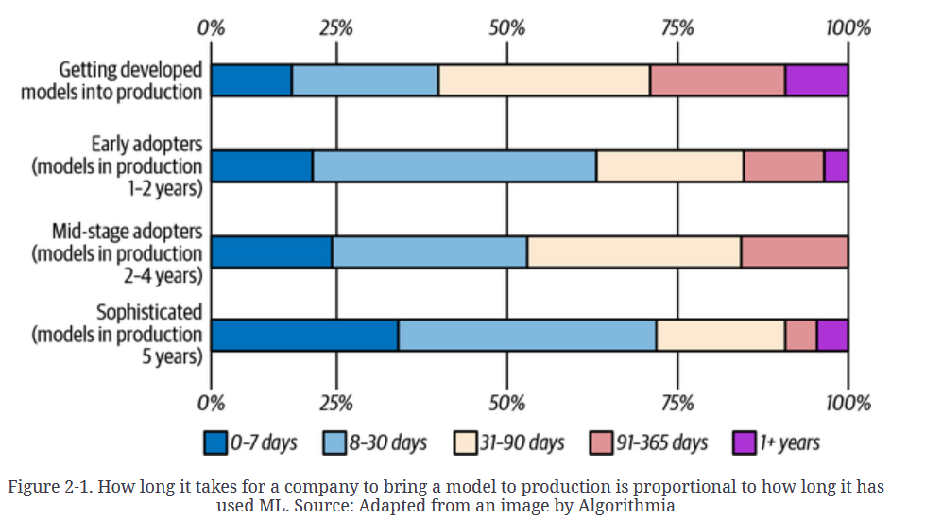
Returns over time

Slide 23
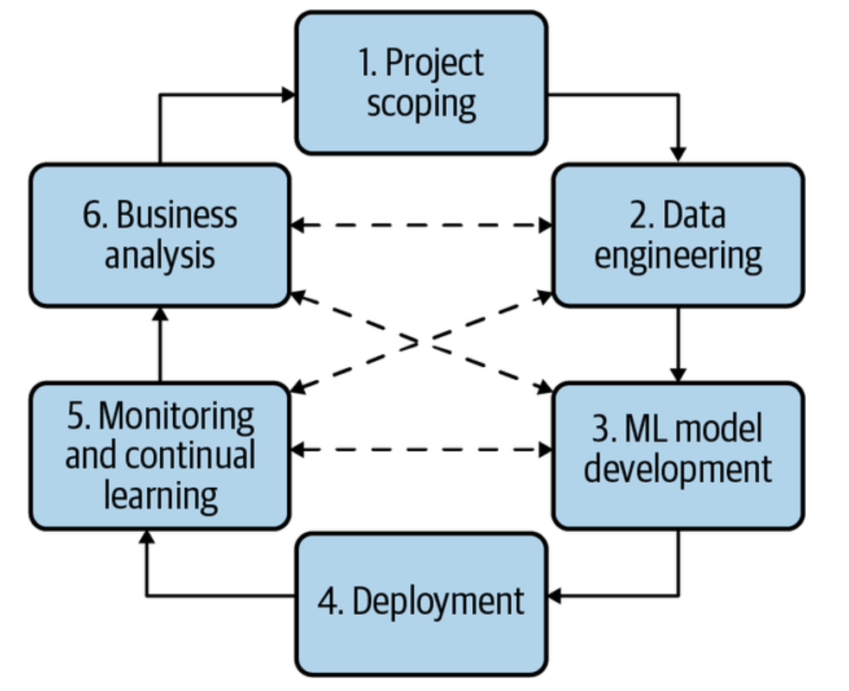
Requirements of ML Systems
Reliability
Scalability
Maintainability
Adaptability

Slide 24
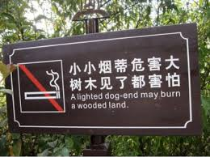
How reliable is your system?
With traditional software systems, you often get a warning, such as a system crash or runtime error or 404. However, ML systems can fail silently. End users don’t even know that the system has failed and might have kept on using it as if it were working.
No errors, it must be working fine!

Slide 25
SYSTEM SCALING
At peak, your system might require 100 GPUs (graphics processing units). However, most of the time, it needs only 10 GPUs. Keeping 100 GPUs up all the time can be costly, so your system should be able to scale down to 10 GPUs.
AWS!
Even Amazon fell victim to this when their autoscaling feature failed on Prime Day, causing their system to crash. An hour of downtime was estimated to cost Amazon between $72 million and $99 million

Slide 26
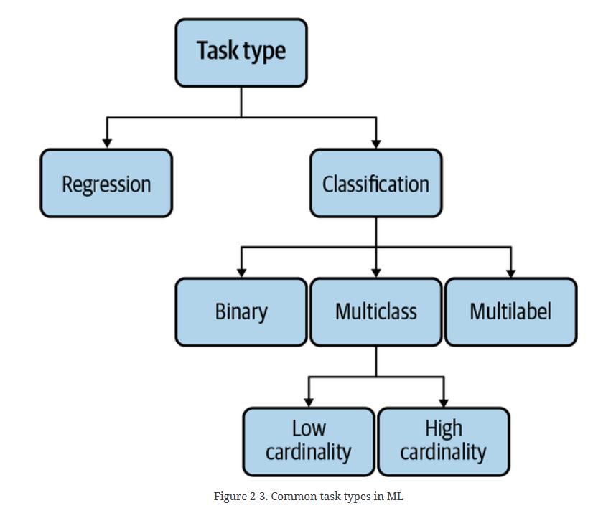
FIND IT TO FRAME IT

Slide 27

What is your objective?
More happiness!
Better health!
More money!
Another shot of Vodka please!

Slide 28
What is your objective?
$$α ∗health+ β∗money+ γ ∗Happiness$$

Slide 29
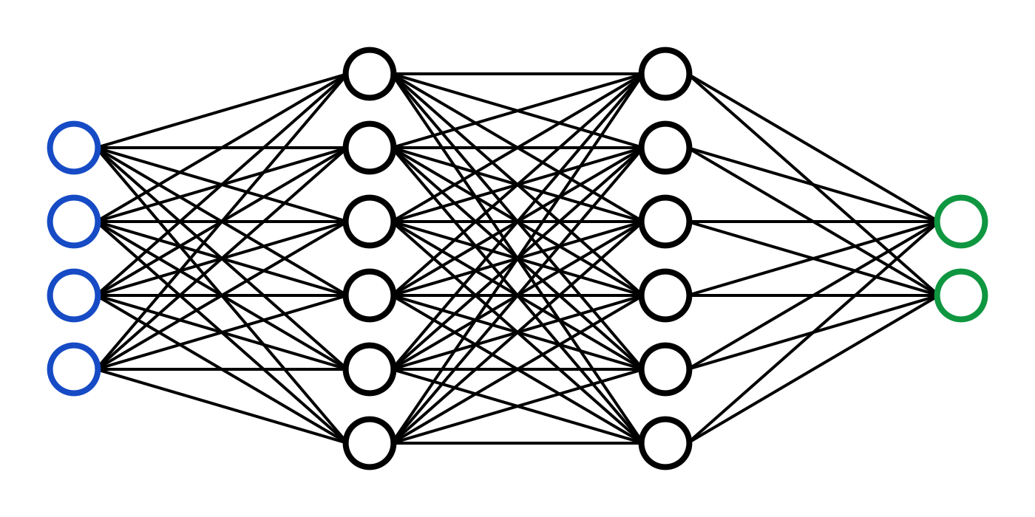
What is your objective?
$$α ∗health+ β∗money+ γ ∗Happiness$$

Slide 30






What is your objective?
$$α ∗$$
$$health$$
$$β ∗$$
$$money$$
$$α ∗health+ β∗money+ γ ∗happiness$$
$$γ ∗$$
$$happniness$$

Slide 31
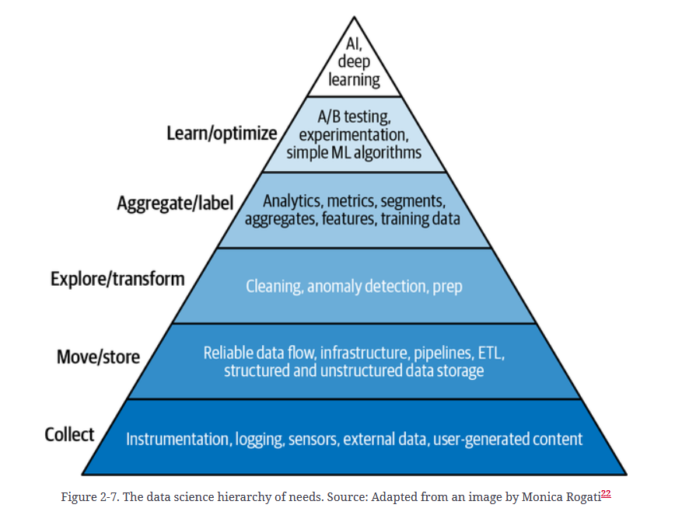
MIND vs Data
Mind
Data

Slide 32
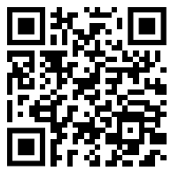
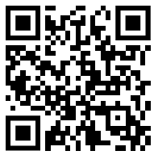
Your voice matters!
Please take some time to fill up our very very short feedback form ☺
If you would like to connect with me, feel free to scan this!
Thank you!

Slide 33

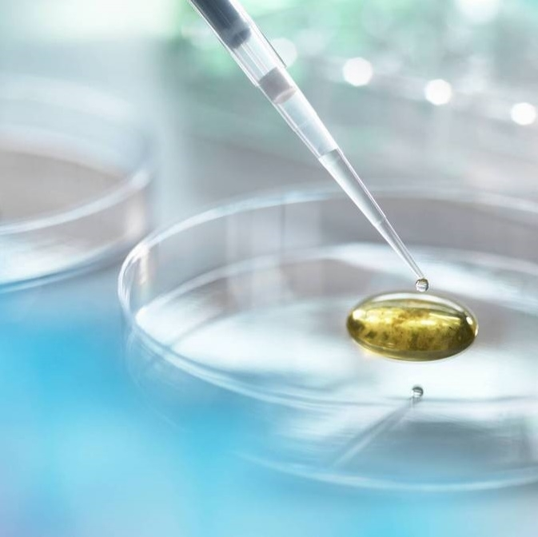
Q&A Time

Slide 34
How can organizations balance the need for collecting diverse data with the ethical concerns around privacy, bias, and consent?

Slide 35
How can teams ensure the reproducibility of ML experiments and results when dealing with large and dynamic datasets?

Slide 36
Have you faced challenges related to data quality and management in your ML projects. How were these challenges addressed?

